Slide 1
Terracing
Slowing down water and minimizing soil erosion

Slide 2
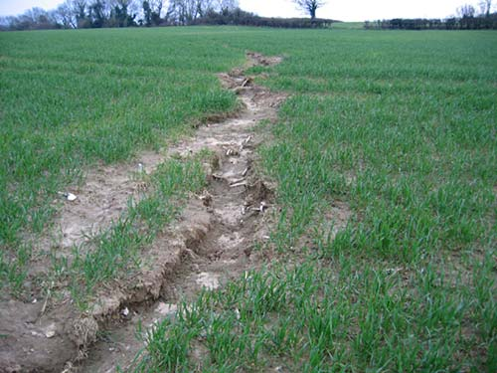
Problem: Design a solution
Your team is a farmer, engineer, and soil scientist.
Can you find a solution to this problem?

Slide 3
Why Terraces?
Reduce rate of runoff and allow soil particles to settle, cleaner water is carried off in a non-erosive manner
Used on farmland with uniform, moderate slope
Terraces collect water and store it until it can infiltrate into the ground or be released through a stable outlet like an underground pipe
Terraces channel and slow runoff water and carry it to a stable outlet like a grassed waterway
Terraces must fit the contour of the land
Grassed terraces can provide increased habitat for birds and other wildlife

Slide 4
Terracing
https://youtu.be/BBLgvN9jA8g

Slide 5
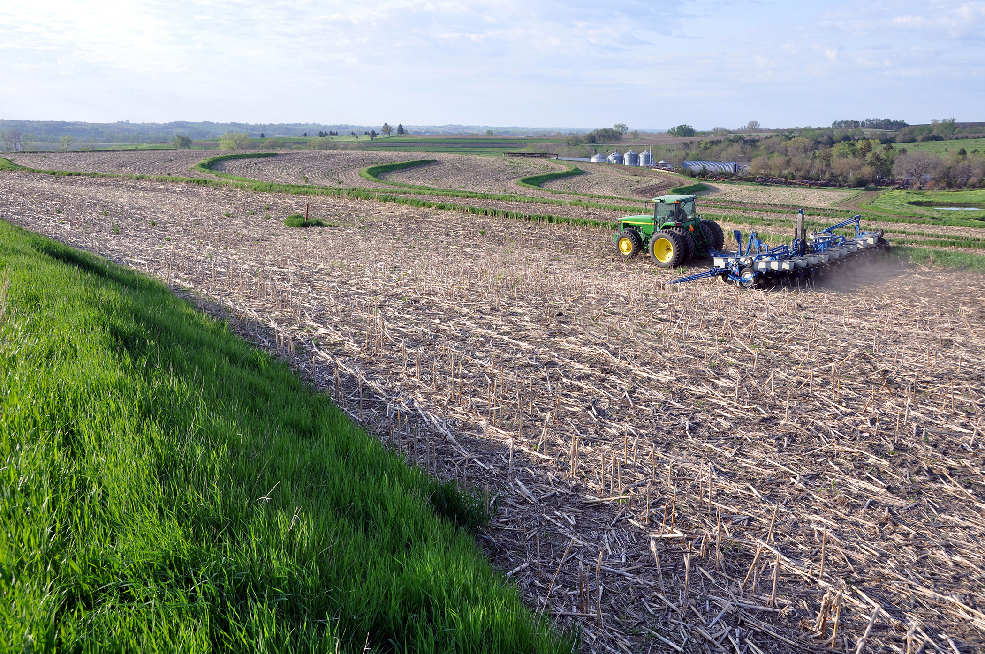
Types of terraces
Grassed back slope
Grass slope on one side, farmed on one side
Benefit: used on slopes greater than 6%
Photo courtesy of USDA-NRCS, Iowa

Slide 6
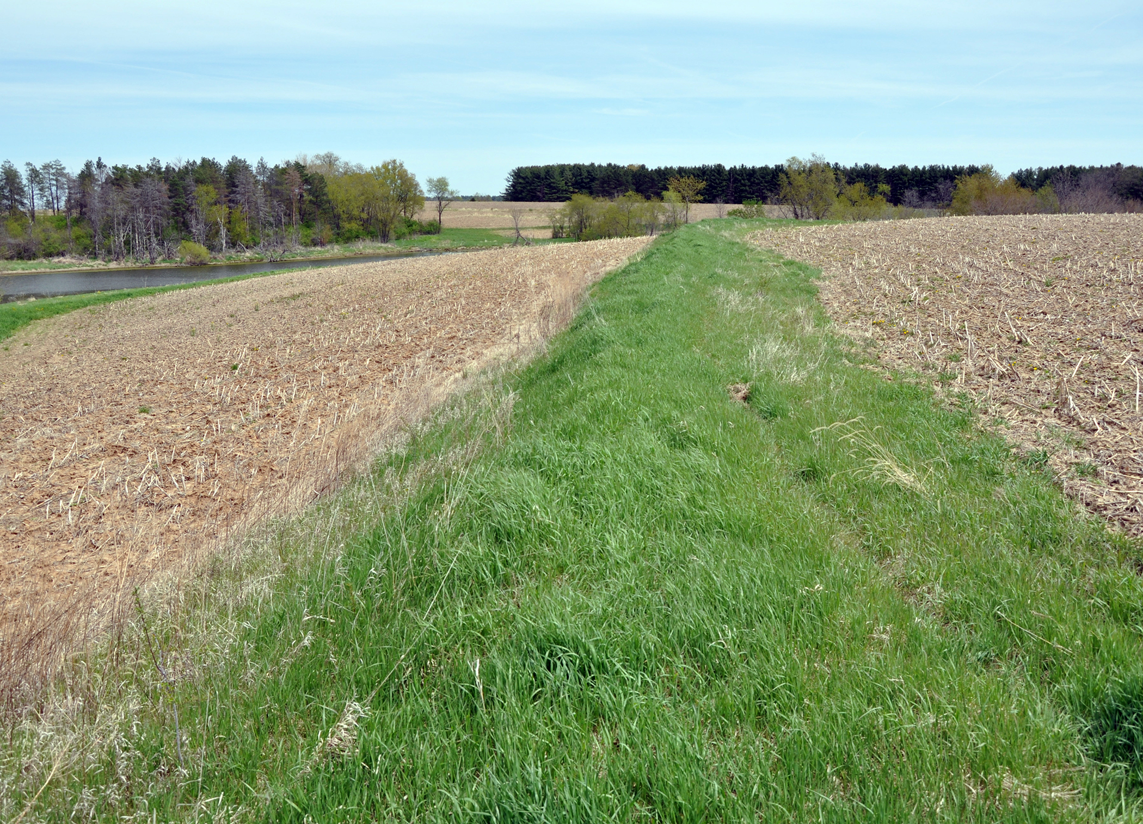
Types of terraces
Narrow base
Grass slopes on both sides
Benefit: used on slopes greater than 6%
Photo courtesy of USDA-NRCS, Iowa

Slide 7
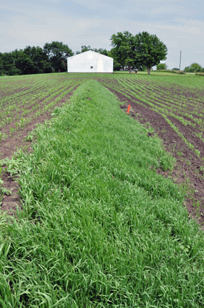
Types of terraces
Steep front, farmable backslope
Should not be built on slopes greater than 6%
Benefit: less ground out of production
Benefit: less maintenance
Benefit: less expensive than broad base
Photo courtesy of USDA-NRCS, Iowa

Slide 8
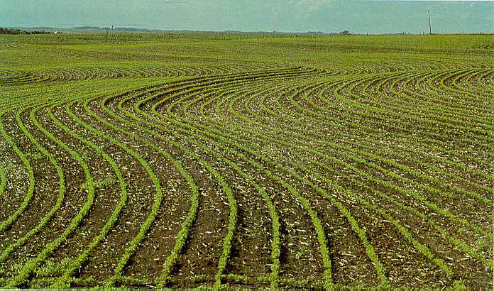
Types of terraces
Broad base
Flatter looking, farmed on both sides
Should not be built on slopes greater than 6%
Benefit: Entire terrace can be farmed
Photo courtesy of USDA-NRCS, Iowa

Slide 9
Types of terraces
Broad base
Flatter looking, farmed on both sides
Should not be built on slopes greater than 6%
Benefit: Entire terrace can be farmed
Photo courtesy of USDA-NRCS, Iowa

Slide 10
Terracing
https://youtu.be/UxHYwrBIyZ8

